Slide 1

VCS
Version Control Systems

Slide 2
Version Control Systems
What Is It?
Track changes
Manage versions
Maintains history
Maintains state
Why Use It?
Organization
Collaboration
Archiving/history
Conflict resolution
Notes:
VCS or Version Control
is a system that records changes to a file or set of files over time so that you can recall specific versions later.
A mechanism to track changes to files and maintain a history of everything changed
especially useful for developers to manage code changes
Why

Slide 3
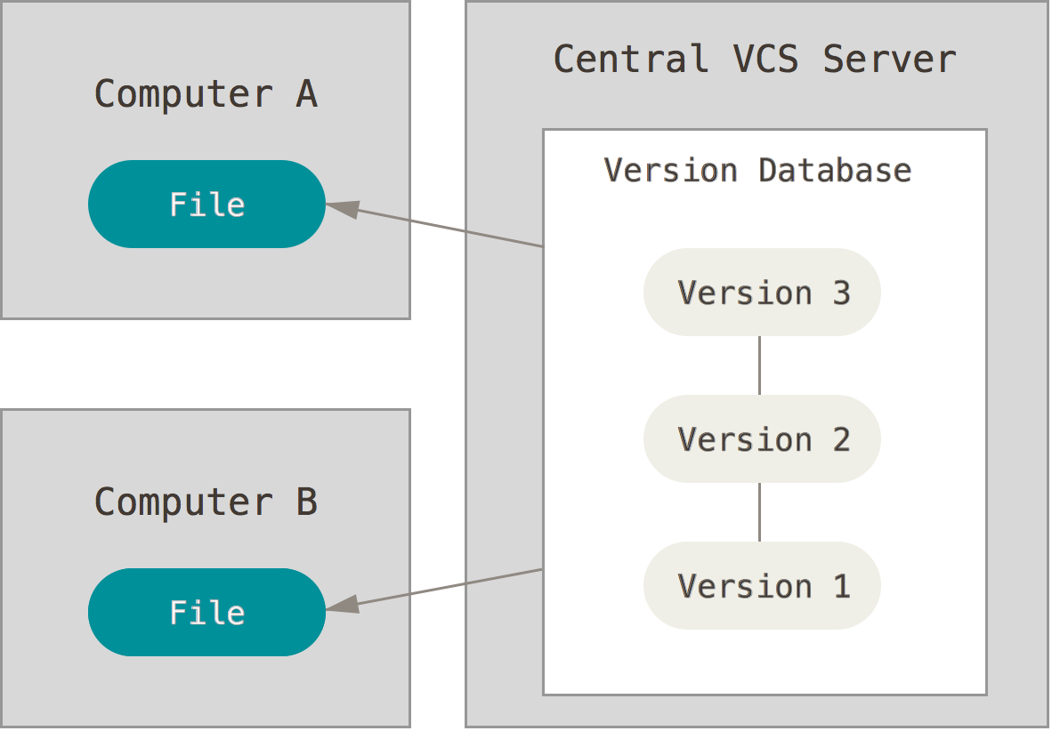
Centralized VCS
Overview
Single repository
History stored in one central location
Typical Workflow
Pull down changes
Make changes
Commit changes
Notes:
Centralized Version Control Systems
Is a single “central” repository that stores history. Everyone pulls and works from this single central repository. Think of it as a common server that everyone has access to and is working from.
Examples:
CVS, subversion, Perforce
Typical Workflow:
Pull down any changes other people have made from the central server.
Make your changes, and make sure they work properly.
Commit your changes to the central server, so other programmers can see them.
Pros
developers know about other developers activities
files may be locked down
easy to administer
fine-grained control over who can do what
Cons
single point of failure
if server goes down, you can’t save versioned changes
if the server gets corrupted, you lose everything (unless you have good backups)
Solution to these problems:
Distributed VCS

Slide 4
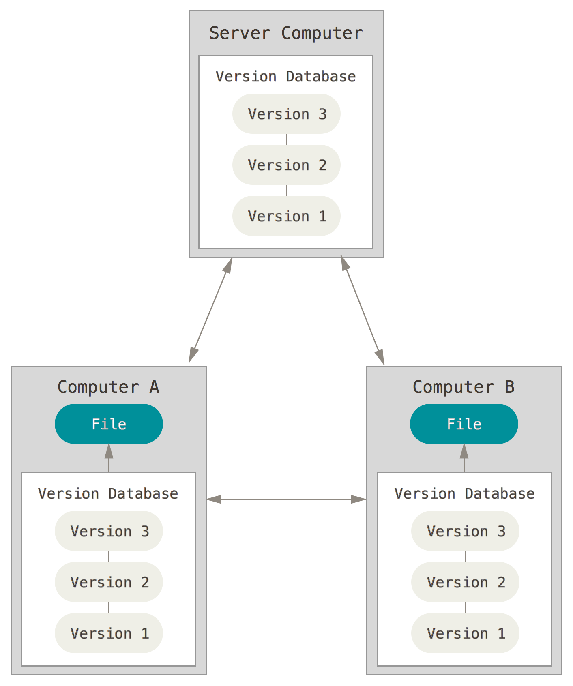
Distributed VCS
Overview
Multiple “central” repos
Every PC is a complete “copy” of the repository
No single point of failure
Network is not involved for common operations
Notes:
Distributed VCS
A set of self contained repositories, which can be linked to each other (called a remote)
Main difference between centralized VCS:
there is no single central repo that controls everything, there are only working copies
every person working with the code has a copy of everything
code, revisions, history, versions, etc
no single point of failure
More:
Advantages Over Centralized Version Control
There is no single central repo that controls everything, there are only working copies
Performing actions other than pushing and pulling changesets is extremely fast because the tool only needs to access the hard drive, not a remote server.
Committing new changesets can be done locally without anyone else seeing them. Once you have a group of changesets ready, you can push all of them at once.
Everything but pushing and pulling can be done without an internet connection. So you can work on a plane, and you won’t be forced to commit several bugfixes as one big changeset.
Since each programmer has a full copy of the project repository, they can share changes with one or two other people at a time if they want to get some feedback before showing the changes to everyone.
Disadvantages Compared to Centralized Version Control
To be quite honest, there are almost no disadvantages to using a distributed version control system over a centralized one. Distributed systems do not prevent you from having a single “central” repository, they just provide more options on top of that.
There are only two major inherent disadvantages to using a distributed system:
If your project contains many large, binary files that cannot be easily compressed, the space needed to store all versions of these files can accumulate quickly.
If your project has a very long history (50,000 changesets or more), downloading the entire history can take awhile.
Two most commonly used DVCS:
Git & Mercurial

Slide 5
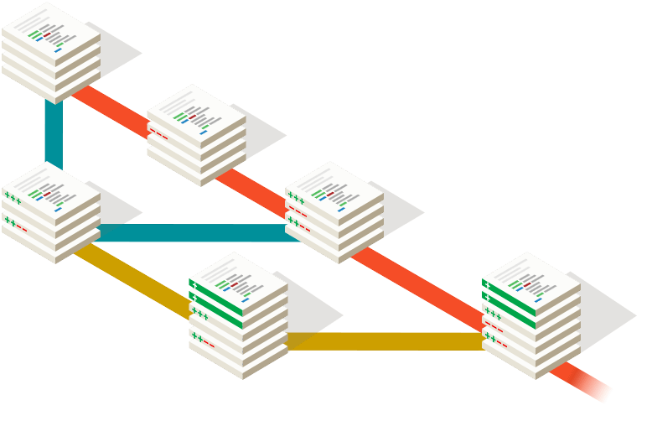

Git
Distributed VCS
Free and open source
Fast, reliable, heavily used
Provides ability to use many different workflows
Most open source projects use Git
See GitHub
Notes:
http://git-scm.com/about

Slide 6
Git Terminology
GitHub Glossary
Blame
Branch
Clone
Collaborator
Commit
Contributor
Diff
Fetch
Fork
Issue
Markdown
Merge
Pull
Pull Request
Push
Remote
Repository
SSH Key
Upstream
Notes:
Blame
The "blame" feature in Git describes the last modification to each line of a file, which generally displays the revision, author and time. This is helpful, for example, in tracking down when a feature was added, or which commit led to a particular bug.
Branch
A branch is a parallel version of a repository. It is contained within the repository, but does not affect the primary or master branch allowing you to work freely without disrupting the "live" version. When you've made the changes you want to make, you can merge your branch back into the master branch to publish your changes.
Clone
A clone is a copy of a repository that lives on your computer instead of on a website's server somewhere, or the act of making that copy. With your clone you can edit the files in your preferred editor and use Git to keep track of your changes without having to be online. It is, however, connected to the remote version so that changes can be synced between the two. You can push your local changes to the remote to keep them synced when you're online.
Collaborator
A collaborator is a person with read and write access to a repository who has been invited to contribute by the repository owner.
Commit
A commit, or "revision", is an individual change to a file (or set of files). It's like when you save a file, except with Git, every time you save it creates a unique ID (a.k.a. the "SHA" or "hash") that allows you to keep record of what changes were made when and by who. Commits usually contain a commit message which is a brief description of what changes were made.
Contributor
A contributor is someone who has contributed to a project by having a pull request merged but does not have collaborator access.
Diff
A diff is the difference in changes between two commits, or saved changes. The diff will visually describe what was added or removed from a file since its last commit.
Fetch
Fetching refers to getting the latest changes from an online repository (like GitHub.com) without merging them in. Once these changes are fetched you can compare them to your local branches (the code residing on your local machine).
Fork
A fork is a personal copy of another user's repository that lives on your account. Forks allow you to freely make changes to a project without affecting the original. Forks remain attached to the original, allowing you to submit a pull request to the original's author to update with your changes. You can also keep your fork up to date by pulling in updates from the original.
Issue
Issues are suggested improvements, tasks or questions related to the repository. Issues can be created by anyone (for public repositories), and are moderated by repository collaborators. Each issue contains its own discussion forum, can be labeled and assigned to a user.
Markdown
Markdown is an incredibly simple semantic file format, not too dissimilar from .doc, .rtf and .txt. Markdown makes it easy for even those without a web-publishing background to write prose (including with links, lists, bullets, etc.) and have it displayed like a website. GitHub supports Markdown, and you can learn about the semantics here.
Merge
Merging takes the changes from one branch (in the same repository or from a fork), and applies them into another. This often happens as a Pull Request (which can be thought of as a request to merge), or via the command line. A merge can be done automatically via a Pull Request via the GitHub.com web interface if there are no conflicting changes, or can always be done via the command line. See Merging a pull request.
Pull
Pull refers to when you are fetching in changes and merging them. For instance, if someone has edited the remote file you're both working on, you'll want to pull in those changes to your local copy so that it's up to date.
Pull Request
Pull requests are proposed changes to a repository submitted by a user and accepted or rejected by a repository's collaborators. Like issues, pull requests each have their own discussion forum. See Using Pull Requests.
Push
Pushing refers to sending your committed changes to a remote repository such as GitHub.com. For instance, if you change something locally, you'd want to then push those changes so that others may access them.
Remote
This is the version of something that is hosted on a server, most likely GitHub.com. It can be connected to local clones so that changes can be synced.
Repository
A repository is the most basic element of GitHub. They're easiest to imagine as a project's folder. A repository contains all of the project files (including documentation), and stores each file's revision history. Repositories can have multiple collaborators and can be either public or private.
SSH Key
SSH keys are a way to identify yourself to an online server, using an encrypted message. It's as if your computer has its own unique password to another service. GitHub uses SSH keys to securely transfer information from GitHub.com to your computer.
Upstream
When talking about a branch or a fork, the primary branch on the original repository is often referred to as the "upstream", since that is the main place that other changes will come in from. The branch/fork you are working on is then called the "downstream".
User
Users are personal GitHub accounts. Each user has a personal profile, and can own multiple repositories, public or private. They can create or be invited to join organizations or collaborate on another user's repository.

Slide 7
Branching
Diverge from main line
Separate functionality
Typically used in a workflow
Continue work without affecting the main line
Merge branches to get functionality into another branch

Slide 8
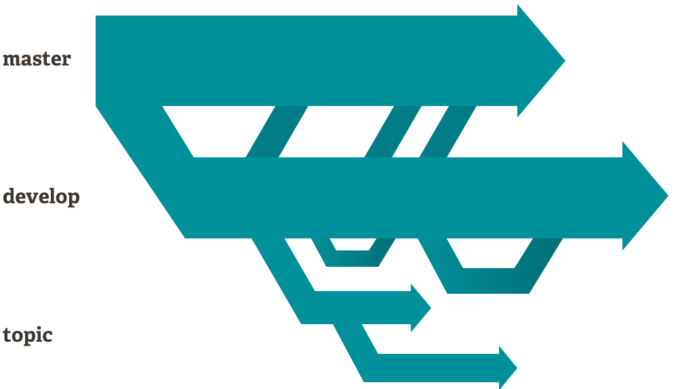
Branching
“master” branch
“develop” branch
“topic” branch
Notes:
https://www.atlassian.com/git/tutorials/comparing-workflows/gitflow-workflow
master: deployable code
develop: working “stable” code
topic: features or actions of work

Slide 9
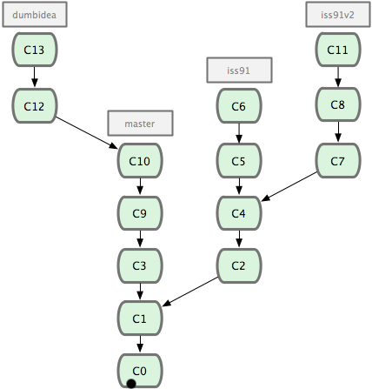
Branching
Work on master
Branch off master
iss91
Branch off issue
iss91v2
Work on master
Branch off master
dumbidea
Notes:
Consider an example of doing some work (on master), branching off for an issue (iss91), working on it for a bit, branching off the second branch to try another way of handling the same thing (iss91v2), going back to your master branch and working there for a while, and then branching off there to do some work that you’re not sure is a good idea (dumbidea branch). Your commit history will look something like

Slide 10
Try Git
https://try.github.io/levels/1/challenges/1
Notes:
Create branches with changes to index.html
intro to GitHub
intro to sourcetree
remote
pull
commit
branch
tag

Slide 11
Resources
API
http://git-scm.com/about/branching-and-merging
http://git-scm.com/blog
http://git-scm.com/book/en/v2
https://www.atlassian.com/git/tutorials/comparing-workflows/feature-branch-workflow
http://x-team.com/2013/09/our-git-workflow-forks-with-feature-branches/

Slide 12
Exercise
Create a GitHub account
Create a new repository in GitHub
Play with it!
Create branches
Add files
Make commits
Push changes
Watch these videos:
GitHub for Beginners
Basics of Git and GitHub
Notes:
https://www.youtube.com/watch?v=0fKg7e37bQE

Slide 13
The End
Version Control Systems

